Slide 1
46 y/o Man, known case of HFrEF since 6 months ago
NYHA FC I-II
PMHx: NECA; No CAD risk factor (DM, HTN, CS, HLP)
  No hospitalization over past 6 months
P/E: BMI: 28, BP:100/80, PR:90, RR:12, O2Sat:96%
  Flat JVP, Clear Lungs, N0 Gallop/murmur, No HSM, Symmetric pulses, No pedal edema
Meds:
  Bisoprolol 5 mg daily
  Lisinopril 5 mg daily
  Furosemide 20 mg BID
  Digoxin 0.25 mg daily

Slide 2
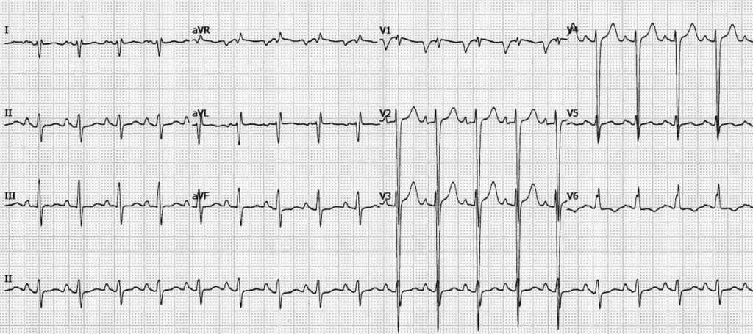
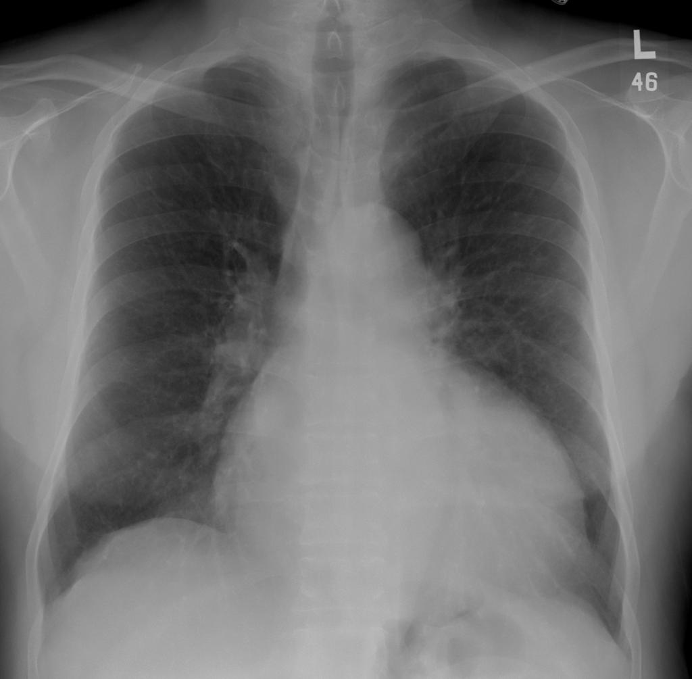
TTE
Moderate LV enlargement; LVEF:25-30%
Moderate to severe functional MR
Normal RV size, mild RV dysfunction
Mild TR, sPAP~30 mmHg
Labs
Na: 131, K:4.6
BUN:30, Cr:1.2
Hb:12
Pro-BNP: 1050
FBS:80, HbA1C:6, LDL:70, HDL:35

Slide 3
Questions
What stage of heart failure is this? What therapeutic options (pharma and non-pharma) can help the symptoms and survival?
How would you optimize patient’s anti-failure regimen?

Slide 10
EMPEROR-Reduced
Adults (≥18 y/o) with HF functional class II, III, or IV & LVEF≤40%
NT-proBNP
Conducted in 565 centers in 20 countries.
3730 patients; randomization 1:1 ratio to receive either empagliflozin 10 mg/d or placebo in addition to their usual therapy for HF.
The median follow-up was 18 months.
≤30% | 31-35% | 36-40% | Atrial fib/flut
≥600 | ≥2500 | ≥3000 | Doubled

Slide 11
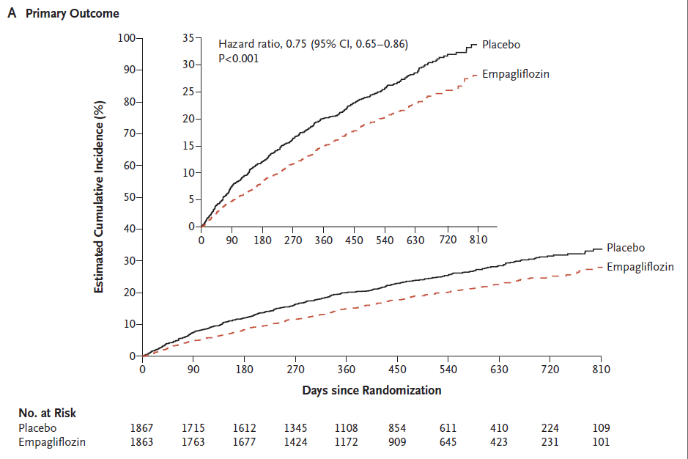
25% ↓ risk of primary composite endpoint of CV death or HF hospitalization
CV death : HR=0.92 (95%CI 0.75-1.12)
Improved (DAPA) vs. no change (EMPEROR) in CV death
First HF hospitalization : HR= 0.69 (95%CI 0.59-0.81)
Primary endpoint:composite of CV death or HF hospitalization.
Secondary endpoint :total HF hospitalizations

Slide 12
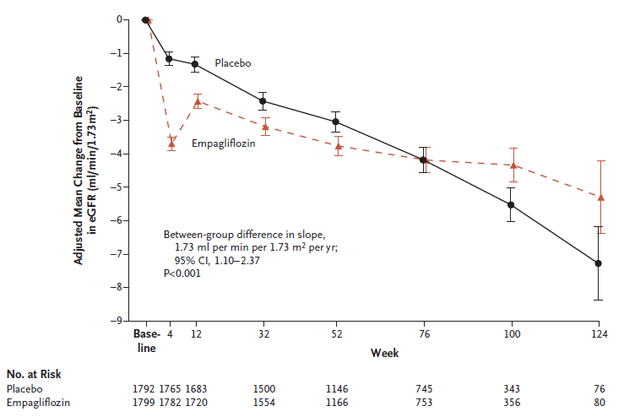
The rate of the decline in eGFR was slower in the empagliflozin group compared with the placebo group
Risk of the composite renal outcome was reduced by 50%

Slide 14
The effect of empagliflozin on the primary composite endpoint was consistent in patients with diabetes and those without diabetes at baseline.

Slide 15
Life Saving Therapies in HFrEF
ACEI/ARB
Beta Blocker
MRA
Ivabradine
H/ISDN
ICD
CRT
Revascularization

Slide 16
Life Saving Therapies in HFrEF
SGLT2i
MRA
Beta Blocker
ARNI
ACEI/ARB
Ivabradine
H/ISDN
ICD
CRT
Revascularization

